Slide 1
CIVL4210 Advanced Construction with AI and Robotics
Assignment 3 tutorial: Construction tools detection
Instructor: Prof. YU, Yantao
Department of Civil and Environmental Engineering
The Hong Kong University of Science and Technology

Slide 2
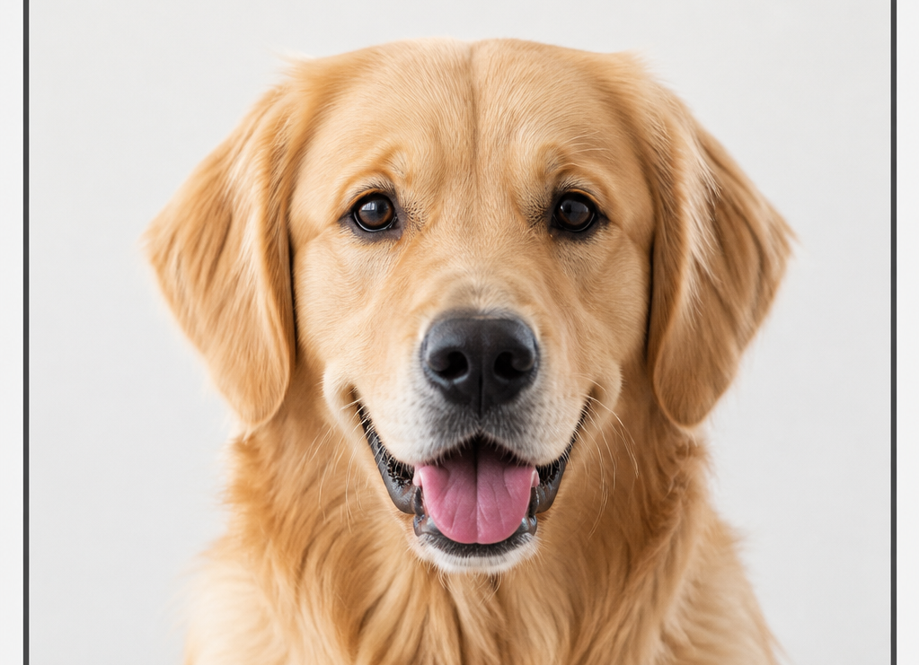
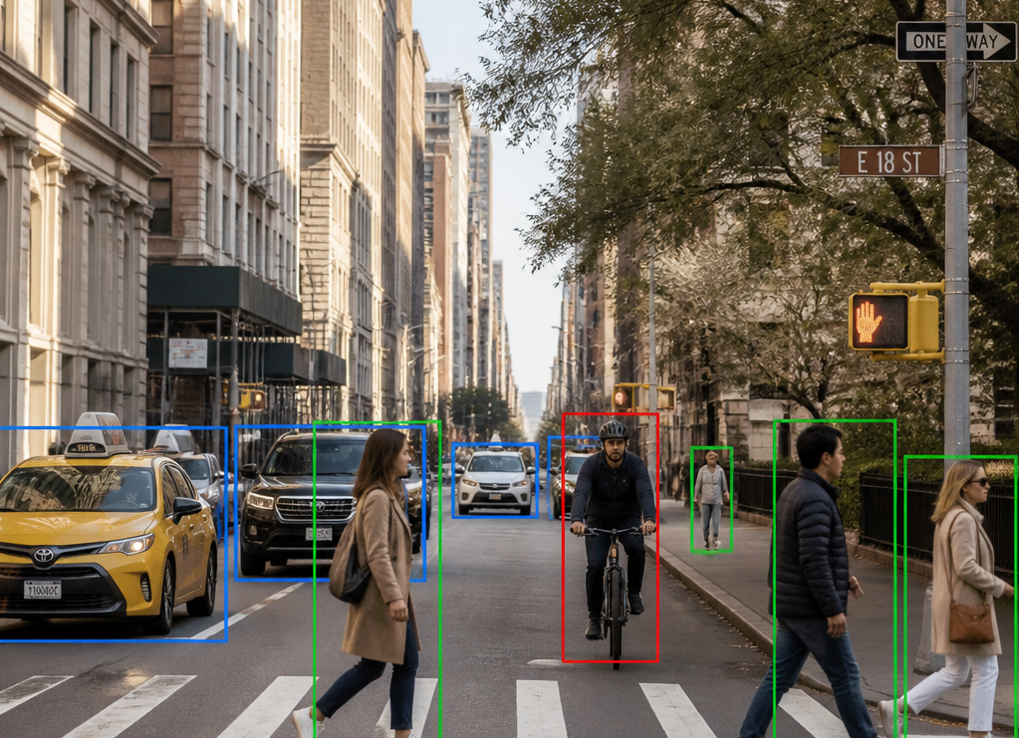
1. Introduction
Why Object Detection？
Moving beyond simple classification to spatial awareness
Classification: What is it?
Detection: What and Where?
Assigns a single label to an entire image, ignoring spatial coordinates. Ideal for simple categorization tasks like identifying animals.
Identifies multiple objects per frame and provides precise bounding box coordinates, essential for spatial awareness.

Slide 3
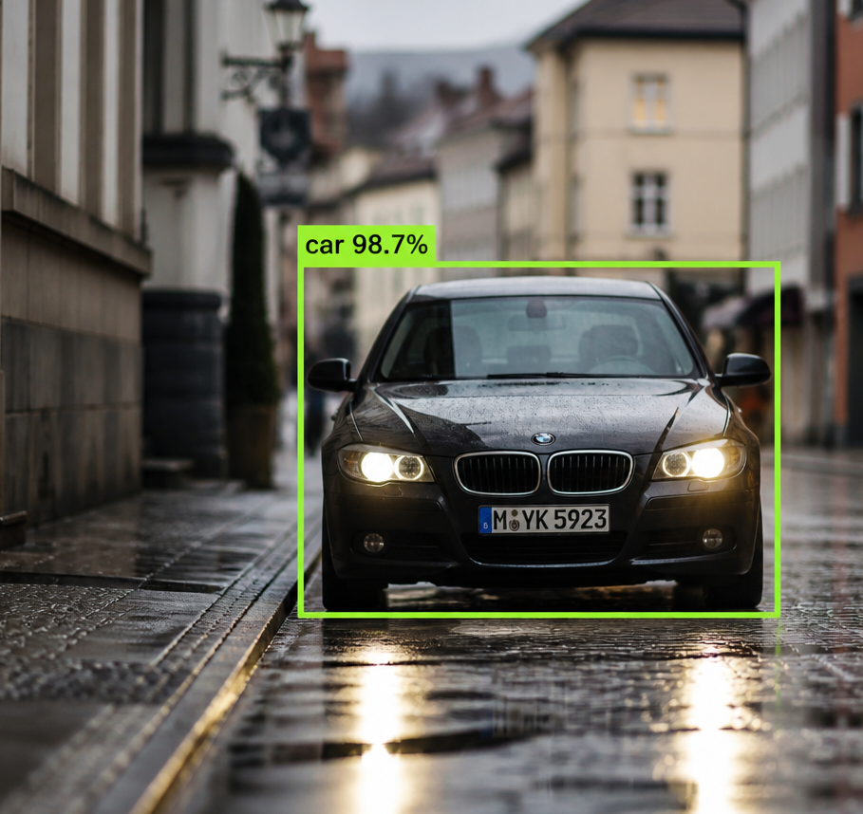
1. Introduction
Understanding Object Detection
Object Category (Label): Identifies the class of the detected object (e.g., car, person, stop sign).
Bounding Box (Coordinates): Defines the spatial location of the object within the frame, typically represented by (x, y) coordinates for the top-left and bottom-right corners.
Confidence Score (Probability): A numerical value representing the model's certainty that the detected object belongs to the specified category.

Slide 4
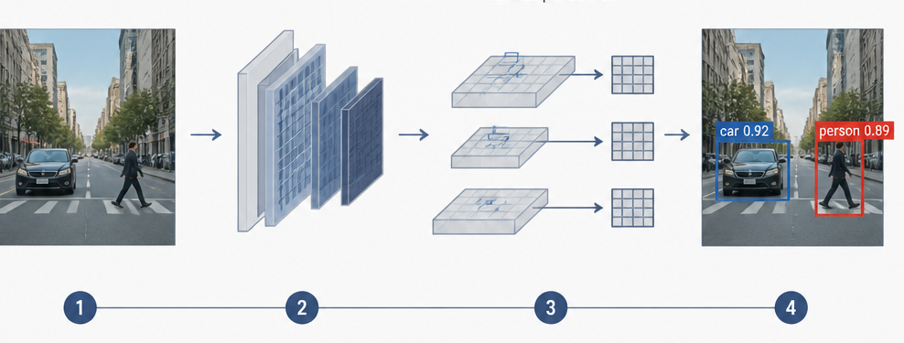
1. Introduction
Why YOLO for Object Detection?
Fast, end-to-end object detection for locating and classifying objects (e.g., construction tools).
Object Detection Pipeline
Image Input
The system receives raw image data as the initial entry point.
Feature Extraction
A deep convolutional neural network processes the image to extract high-level feature maps.
Prediction
The model predicts bounding boxes, confidence scores, and class probabilities simultaneously across a grid.
Final Detection
Non-maximum suppression is applied to filter redundant boxes and output the final object detections.

Slide 5
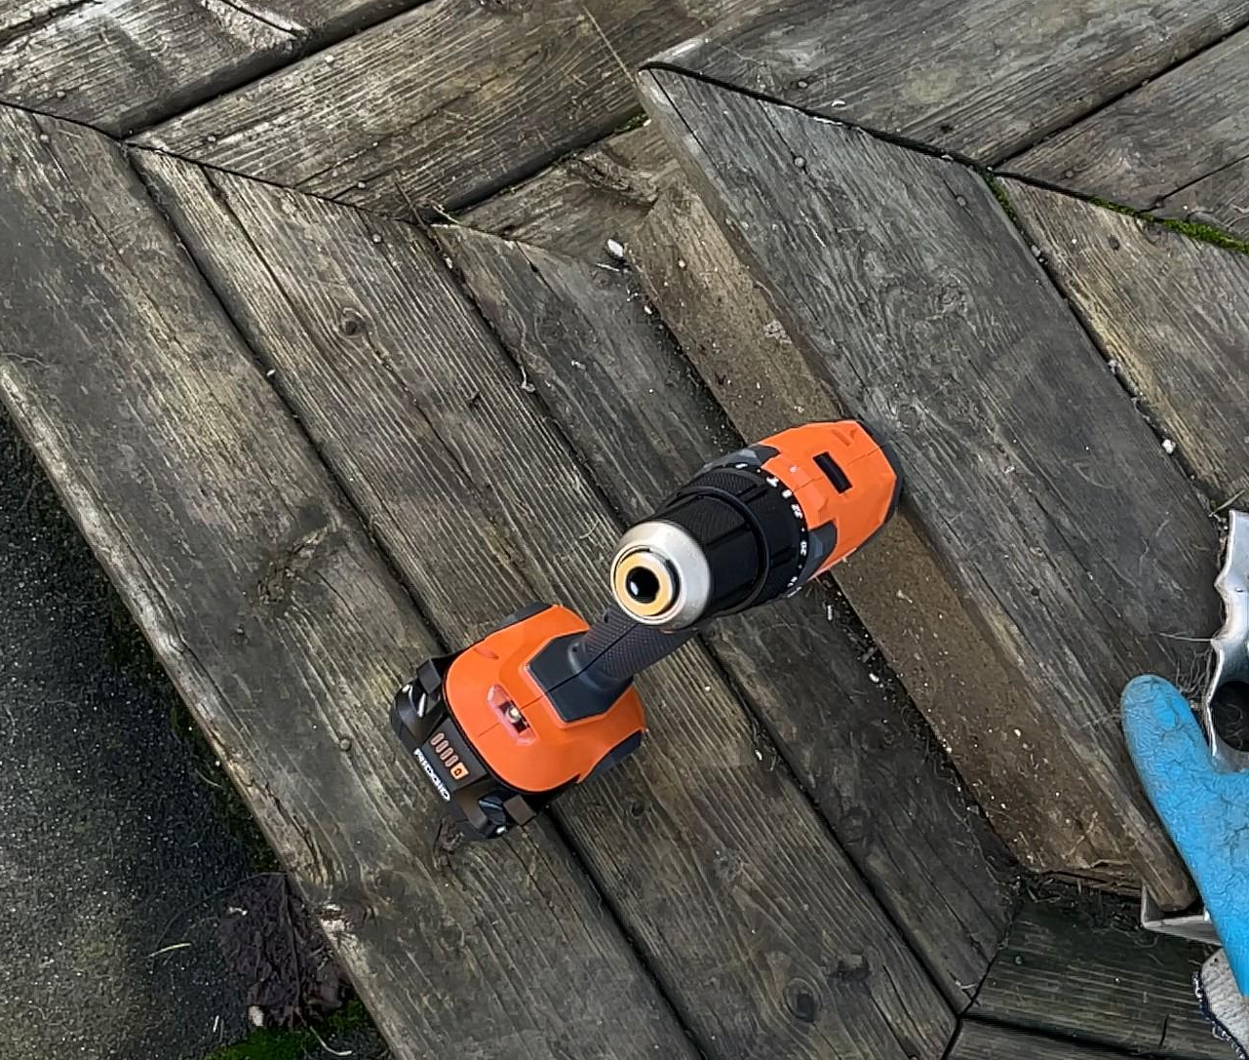
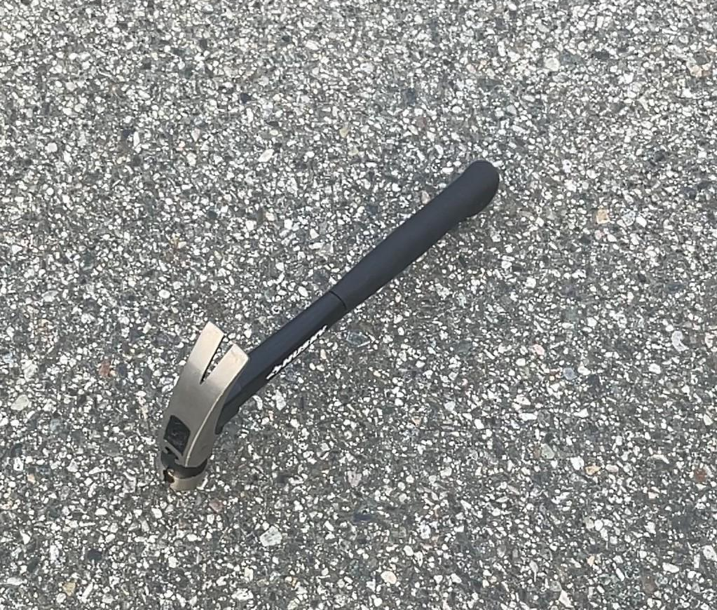
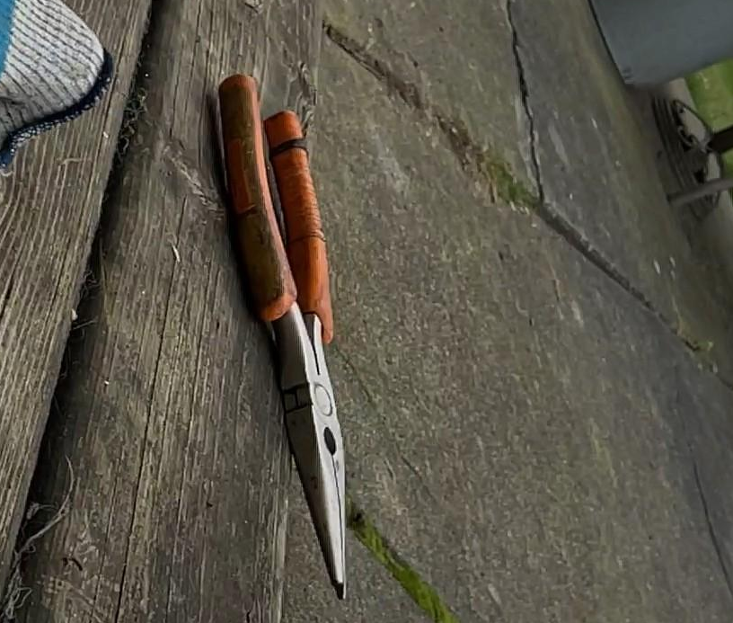
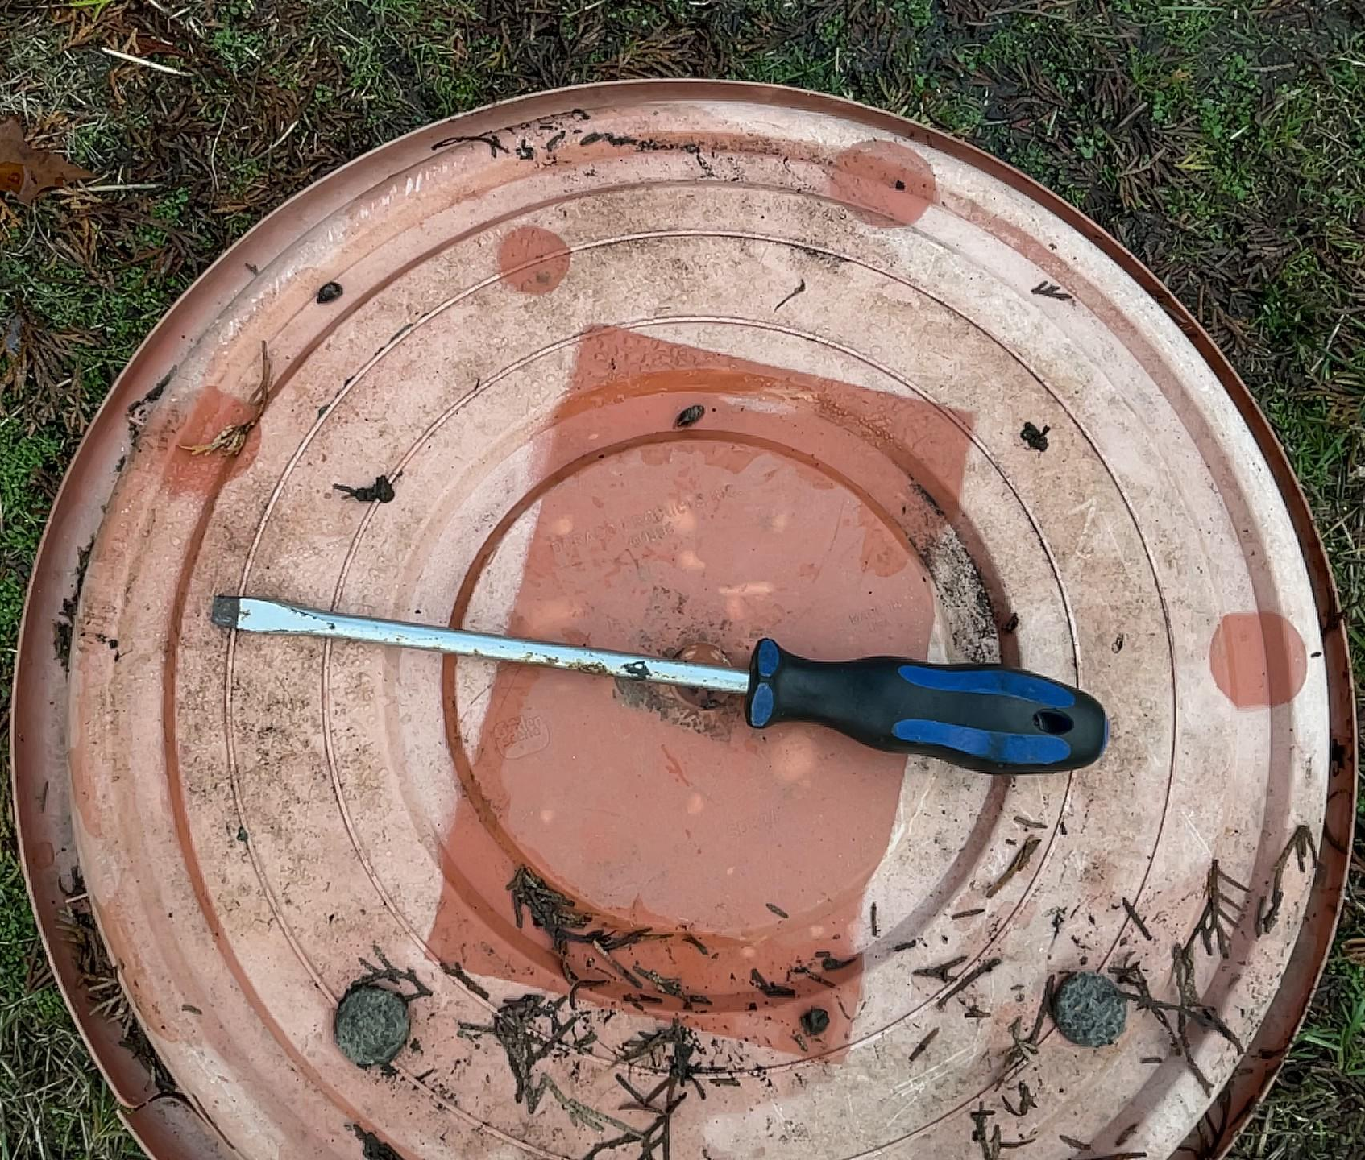
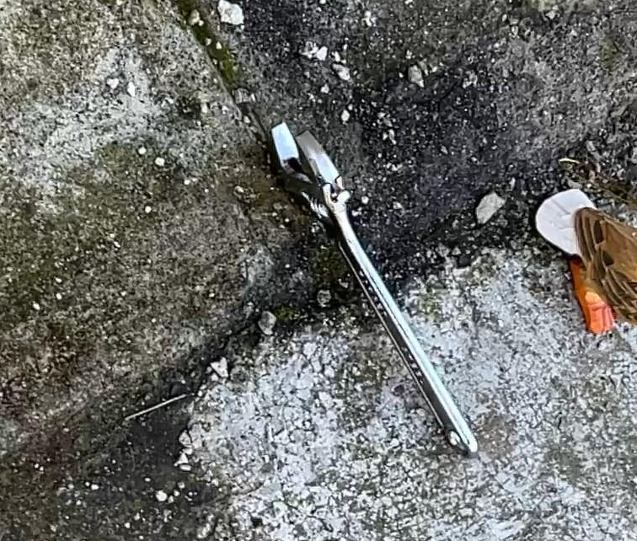
2. Dataset
Total images: 5204
Training: 3640
Validation: 1034
Test: 529
Data Sources
Kaggle
Ronoflow
Google images
Classes Annotated
Drill
Hammer
Pliers
Scredriver
Wrench

Slide 6





3. YOLO Tutorial Workflow
A step-by-step guide to object detection implementation
3
Model Input
1
Pre-process and normalize images for model ingestion.
1
Environment Setup
Configure dependencies and hardware acceleration.
5
2
4
Detection
Run inference to identify objects and bounding boxes.
2
Model Loading
Initialize the YOLO architecture with pre-trained weights.
5
Visualization
4
3
Apply post-processing and display detection results.

Slide 7

3. YOLO Tutorial Workflow
Environment Setup
Python
The foundational language providing the glue and orchestration for the AI pipeline.
YOLO Library
The high-performance engine for real-time object detection and classification.
OpenCV
Essential utility for image pre-processing, data manipulation, and visual annotation.
Matplotlib
The primary interface for data visualization, performance plotting, and result analysis.

Slide 8
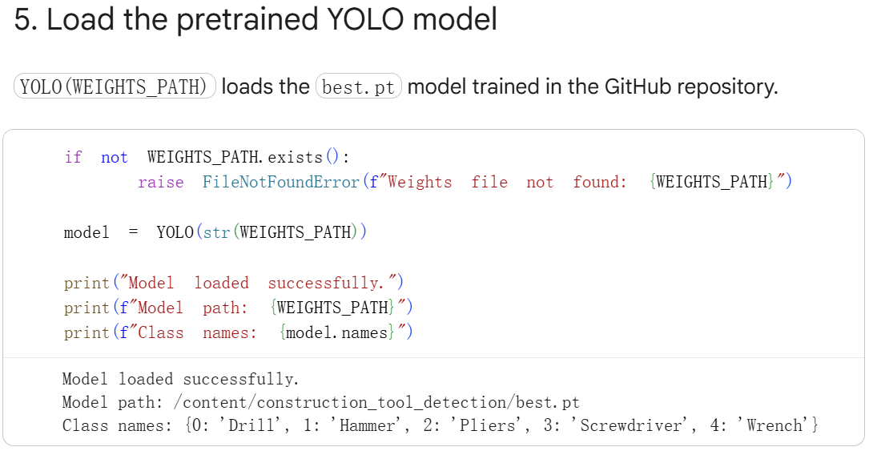

3. YOLO Tutorial Workflow
Loading a Pre-trained YOLO Model
The Power of Pre-training: Utilize models already trained on massive, diverse datasets to capture general feature representations.
Efficiency Gains: Drastically reduce training time and resource requirements by bypassing the need to learn basic visual patterns from scratch.
Model Weights: Best.pt
The notebook retrieves the project's trained weights from the configured GitHub repository. This is the custom detector used for the five construction-tool classes.

Slide 9



3. YOLO Tutorial Workflow
Preparing the Input
One detection model supporting static images, recorded videos, and real-time camera streams
Webcam
Video
Image
Versatile Media Support
Handles various formats: static images for batch processing, video files for frame-by-frame tracking, and live camera streams for real-time inference. In this notebook, we choose a single-frame image as the test input.
Pipeline Integration
Standardized preprocessing including resizing, normalization, and padding to ensure seamless transition into the YOLO architecture.

Slide 10
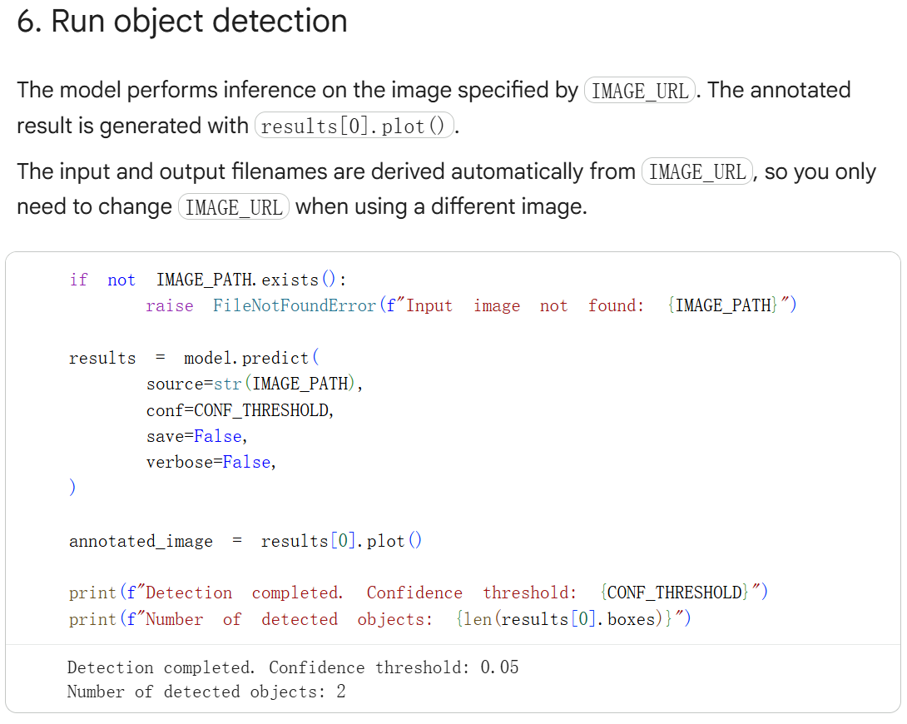
3. YOLO Tutorial Workflow
Running Detection
The model inference produces raw predictive data essential for downstream processing and validation.
Class Labels: Identifiers for the detected objects.
Box Coordinates: Spatial definitions (bounding boxes) locating objects within the frame.
Probability Values: Confidence scores indicating the model's certainty for each detection.

Slide 11
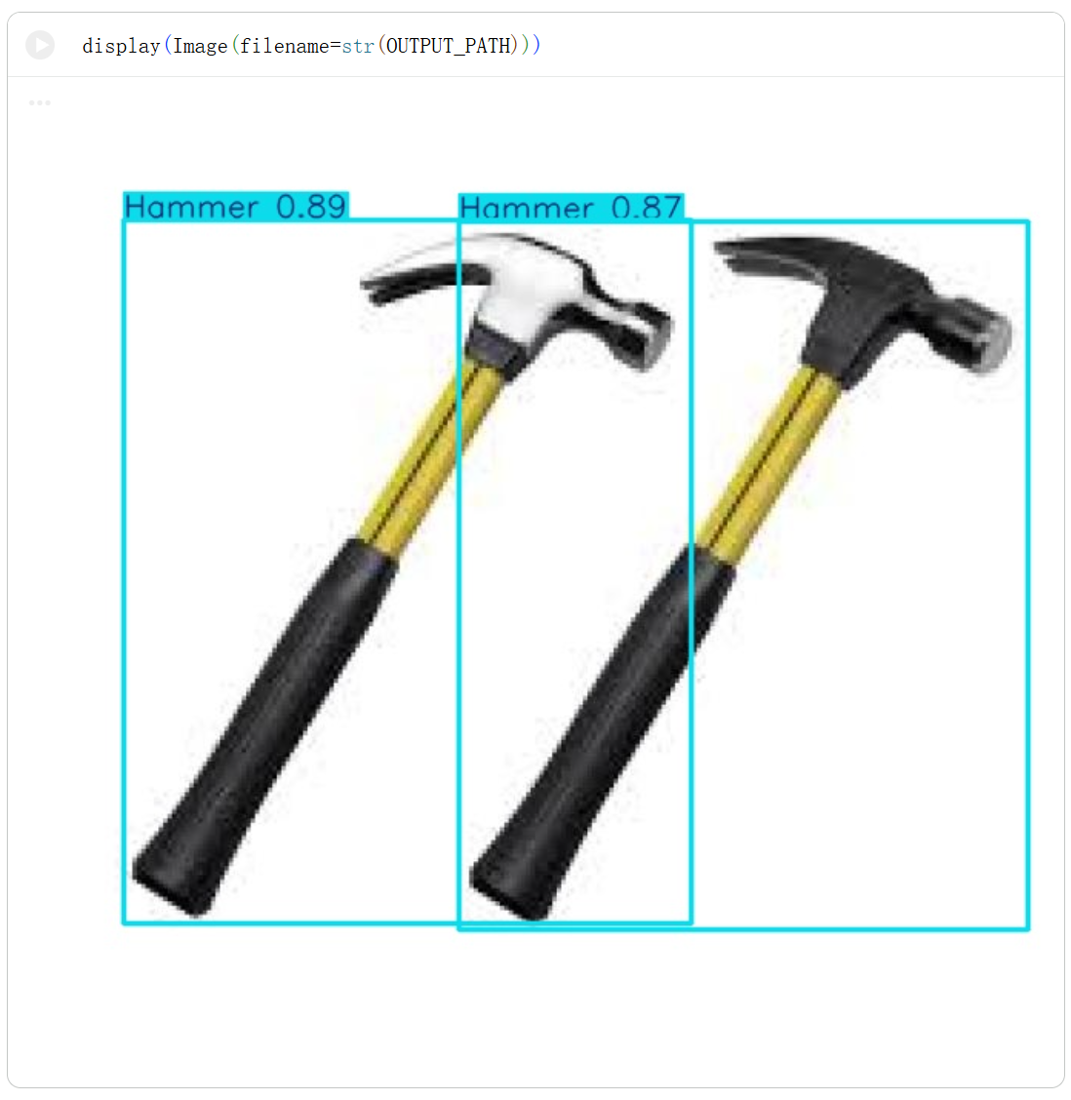
3. YOLO Tutorial Workflow
Visualizing Results
Bounding Boxes: Precisely identifies the spatial location of objects within the frame as detected by the model.
Color-Coded Labels: Categorizes identified objects visually, allowing for instant differentiation between distinct classes.
Confidence Scoring: Overlays numeric probability scores to represent the model's certainty level for every detected instance.
Visual Verification: Annotated image displays showing output masks and enlarged snippets for fine-grained label inspection.

Slide 12

4. Reference
Resource List
Project repository: project resources, custom-trained weights, and example images used by the notebook, https://github.com/yantaolab/Autonomous-Construction-and-Robotics/tree/main/Projects/Project%2003%20Construction%20Tool%20Classification.
Ultralytics YOLO documentation: Official documentation for Python usage, training and prediction, https://docs.ultralytics.com/.
YOLO, foundational paper: Redmon, J., Divvala, S., Girshick, R., & Farhadi, A. (2016). You Only Look Once: Unified, Real-Time Object Detection. CVPR 2016, doi: 10.1109/CVPR.2016.91.
OpenCV documentation: Essential documentation for image processing and computer vision tasks, https://docs.opencv.org/5.0/.
Google Colab documentation: Reference for hosted notebook execution and runtime considerations, https://colab.research.google.com/.

Slide 13
5. Assignments
Task 1. Run the detection model (YOLO) on test images
Requirement
(1) Randomly select 5 images from the test/images folder. Please note that images containing multiple tools should be chosen, as they are more helpful for addressing Task 2.
(2) Load the pre-trained YOLO model.
(3) Run object detection on selected images.
(4) Save and display detection results.
Learning Goal: Understand the basic YOLO inference workflow.
Task 2. Modify detection confidence threshold
Requirement
(1) Run detection using different confidence thresholds: 0.25, 0.50 and 0.75.
(2) Compare: (a) Number of detected objects; (b) False detections; and (c) Missing objects.
(3) Discussion: How does confidence threshold affect the final result?
Learning Goal: Understand prediction filtering.

